Slide 1
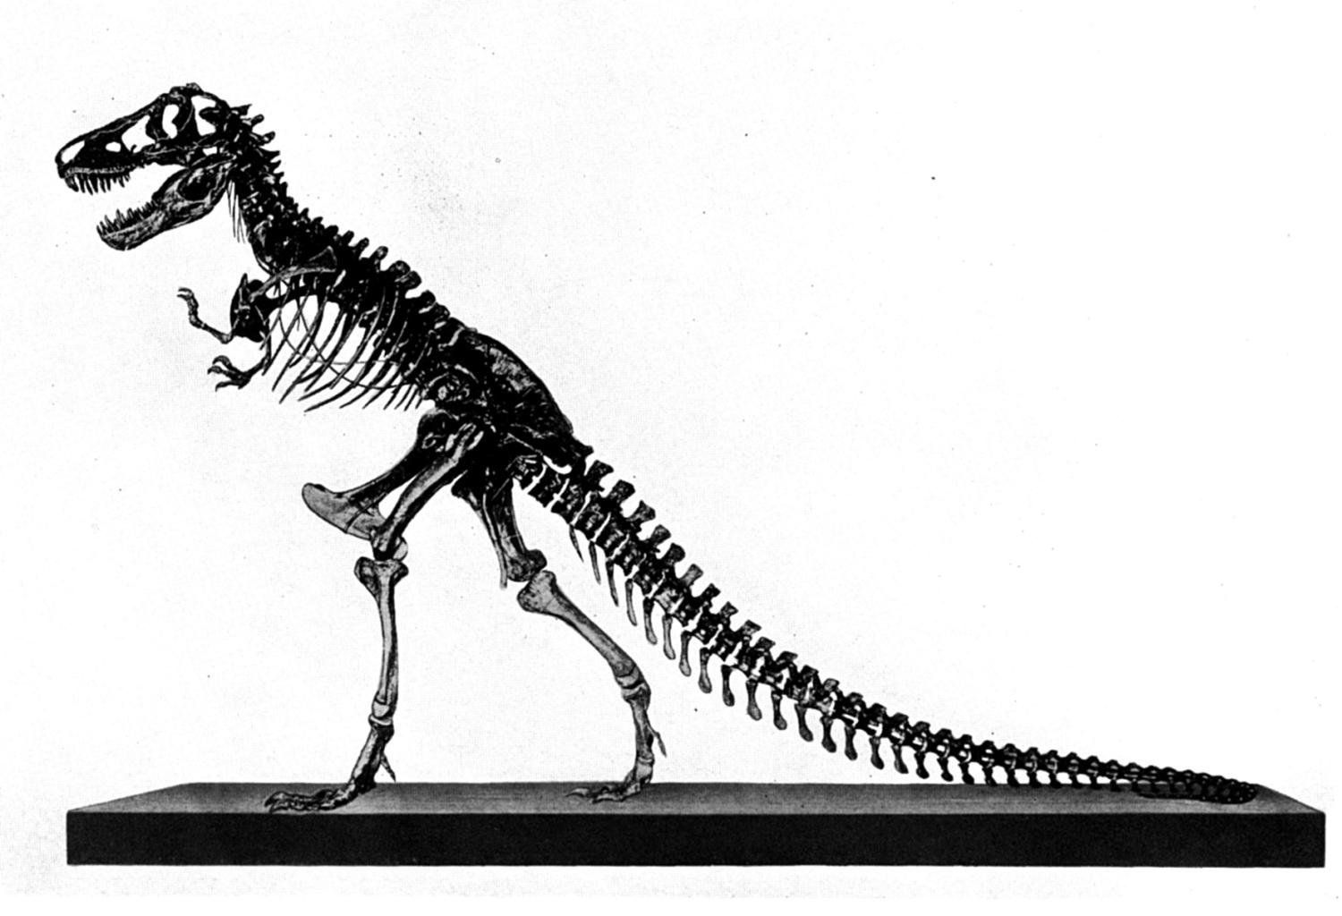
Behemoth &
Leviathan
Job 40:15-41:34
(context)
Part 2b

Slide 2
Review:
1 evidence for dinosaurs and man living together
2_{a} the conflict between Job and his friends and between Job and God
2_{b} Elihu’s response
2_{c} Jehovah’s response
concept
context
Today’s Lesson
Notes:
More will view the Bible as not being sacred due to not believing it is accurate. Think about it, if the Bible teaches that thorns were the product of sin-cursed world, then how could the bible be true if thorns existed for millions of years before Adam and Eve? Hence, millions of years is a direct war against the scriptures.

Slide 3
Elihu (Job 32:1-3)
1 So these three men ceased answering Job, because he was righteous in his own eyes.
2 Then the wrath of Elihu, the son of Barachel the Buzite, of the family of Ram, was aroused against Job; his wrath was aroused because he justified himself rather than God.
3 Also against his three friends his wrath was aroused, because they had found no answer, and yet had condemned Job.

Slide 4

Elihu’s Correct Rebuke (Job 33:8-13)
8 "Surely you have spoken in my hearing, And I have heard the sound of your words, saying,
9 ‘I am pure, without transgression; I am innocent, and there is no iniquity in me.
10 Yet He finds occasions against me, He counts me as His enemy;
11 He puts my feet in the stocks, He watches all my paths.’
12 "Look, in this you are not righteous. I will answer you, For God is greater than man.
13 Why do you contend with Him? For He does not give an accounting of any of His words.
Notes:
Job started out well by not sinning with his words. But in the course of time, he actually brought a charge against God and Elihu correctly points out that he was actually contending with God (see Job 10:2cf. Is. 45:9; 1 Cor. 10:22).

Slide 5
Oppressions (Job 35:9)
Multitude of oppressions (9)
  Job understood the world was filled with a multitude of oppressions (24:1-12)
  Became perplexed why God’s government would allow the wicked to prosper (12:6; 21:7ff)
Notes:
Job is now in the general class of sufferers and yet he has done his all to live upright before God

Slide 6
No One Says (Job 35:10)
But no one says… (10)
  Elihu’s counter is that even the general class of sufferers do not inquire of God where songs can be found in calamity (cf. Acts 16:25)
  The oppressor and the oppressed both fail!

Slide 7
Who Teaches (Job 35:11)
Who teaches us more than the beasts (11)
  Man was given the capacity to learn and understand
  The one who refuses to learn and grow in adversity is like a beast in the animal kingdom
    An animal may roar and cry in hardship, but does not appeal to God

Slide 8
Cry Out… (Job 35:12)
There they cry out, but He does not answer (12)
  To cry out in complaint is not a prayer for mercy
  Care in not crying against God, but to God
    “They blasphemed the God of heaven because of their pains and their sores, and did not repent of their deeds” (Rev. 16:11)
Notes:
Barnes noted, “Many of the afflicted have no peace or consolation in their trials — no ‘songs in the night’ — BECAUSE THEY ARE TOO PROUD TO PRAY!”

Slide 9
Pride (Job 35:12)
Because of the pride of evil men (12)
  Pride is man’s downfall and is present even in the oppressed—it is a universal plague
  Leviathan was brought before Job for this very purpose (Job 41:33, 34)
    No man would debate or challenge Leviathan
    No man would call his ways into question
    But who created Leviathan?
    Is man “duty-bound” to submit to God only if he can “reason out” the moral government of God?
Notes:
God created Leviathan and deserves to be honored whether we understand His ways or not. This is a most fundamental point given early on in man’s history.
Today we know more about the moral rule of God through the New Testament than what Job did. We know there is a judgment day coming. We know that there is life after the grave and man will account for what he did with his life. We know that God suffered because of man’s sin and that Jesus came to save us from sin. But even if we didn’t know that, we are still bound to honor the creator because, He is the creator!

Slide 10

Empty Talk (Job 35:13)
God will not listen to empty talk (13)
  Vain talk turns away God (Job 9:22-24)
  How often do men utter empty things when afflicted?
    “Why has God brought this upon me?”
    “How can a God of love allow so much suffering?”
    “It must be God’s will!”
    Ecclesiastes 5:1, 2
Notes:
RE: “It must be God’s will” –really? Is it really God’s will for a man to be paralyzed in a car wreck? For a woman to be raped? For a house to burn down on a family, for people to suffer with all kinds of diseases? Why do so few ever talk about Satan’s will (Lk. 13:16; Acts 10:38). Was Jesus undoing God’s will in these healings?
Others have said in a belittling way, “The Man upstairs is asleep at the wheel” or “you must have done something really evil to bring on this calamity” (cf. Acts 28:3, 4).

Slide 11
Call &Wait (Job 35:14-16)
14 Although you say you do not see Him, Yet justice is before Him, and you must wait for Him.
15 And now, because He has not punished in His anger, Nor taken much notice of folly,
16 Therefore Job opens his mouth in vain; He multiplies words without knowledge."
14 Although you say you do not see Him, Yet justice is before Him, and you must wait for Him.
15 And now, because He has not punished in His anger, Nor taken much notice of folly,
16 Therefore Job opens his mouth in vain; He multiplies words without knowledge."
Notes:
Just because we do not see God actively destroying the wicked or because we do not see the relief coming from our personal suffering, does not mean that justice is not before Him. Hence, Elihu charges Job with speaking words without knowledge because he spoke harshly against God. There can be things which are not seen, but are nevertheless there. Job did not know that Satan was behind these things and that in the balance was the question “will man love God without the pay?”

Slide 12
“Will A Man Love God Without Earthly Rewards?”
The Question In Conflict…

Slide 13
Will We Prove Satan WRONG?
4 So Satan answered the LORD and said, "Skin for skin! Yes, all that a man has he will give for his life.
5 "But stretch out Your hand now, and touch his bone and his flesh, and he will surely curse You to Your face!"
Job 2:4, 5
“Do not fear any of those things which you are about to suffer. Indeed, the devil is about to throw some of you into prison, that you may be tested, and you will have tribulation ten days. Be faithful until death, and I will give you the crown of life” (Rev. 2:10)
Notes:
Is Satan right about you and me? Will we hold fast to righteousness only if everything goes well? Will we give all that we have for our life? Or will we be like Jesus and be willing to give up all, even our life, to remain true to the will of God?

